Slide 1
Data Link Layer

Slide 2
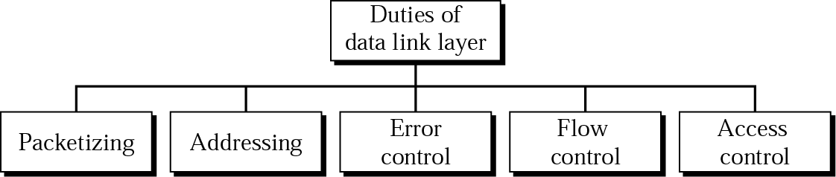
Data link layer duties

Slide 3
Error Detection and Correction
Data can be corrupted during transmission.
For reliable communication, error must be detected and corrected
Error Detection and Correction are implemented either at the data link layer or the transport layer of the OSI model

Slide 4
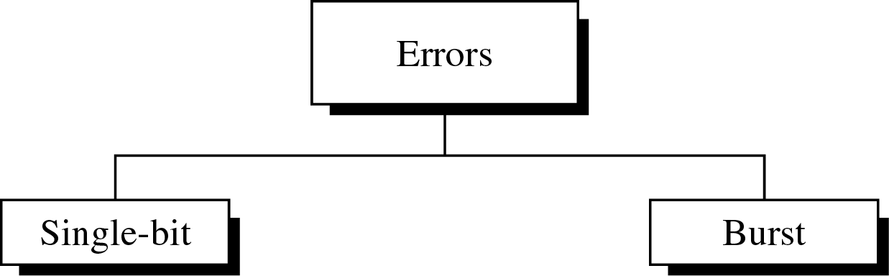
Type of Errors

Slide 5
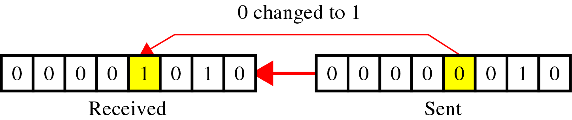
Single-Bit
~ is when only one bit in the data unit has changed

Slide 6
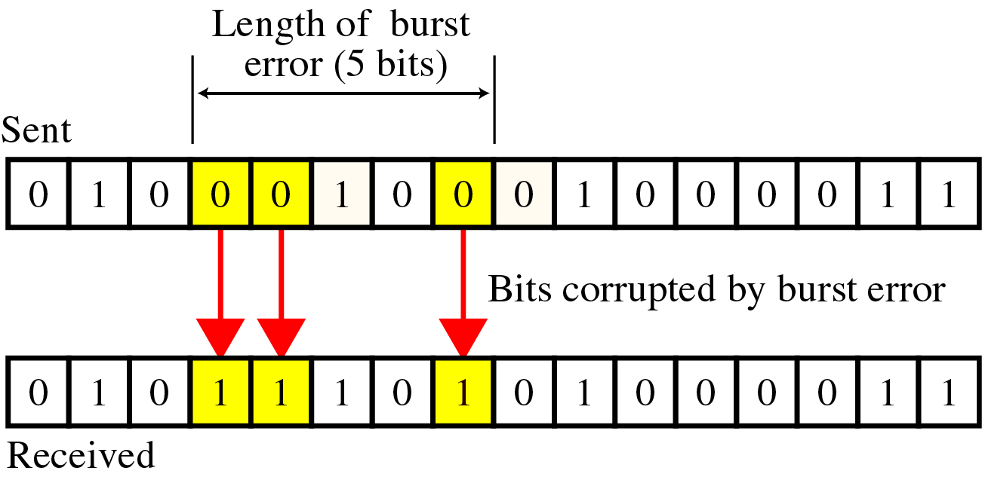
Burst Error
~ means that 2 or more consecutive bits in the data unit have changed

Slide 7
Detection
Error detection uses the concept of redundancy, which means adding extra bits for detecting errors at the destination

Slide 8
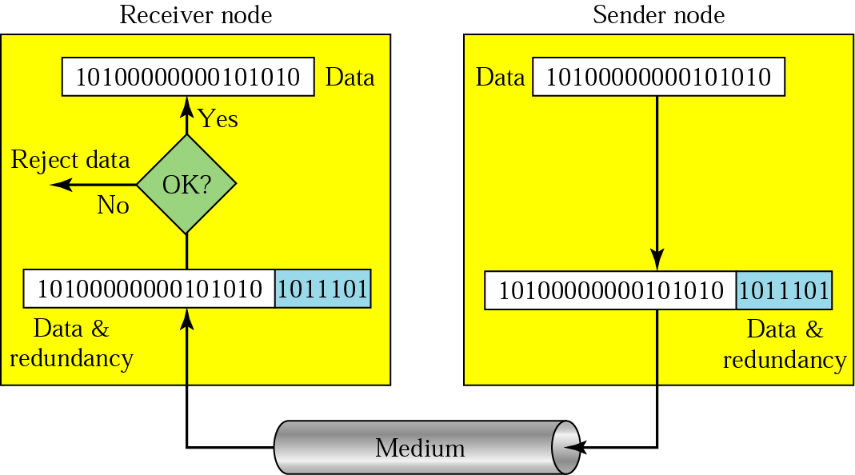
Detection(cont’d)
Redundancy

Slide 9
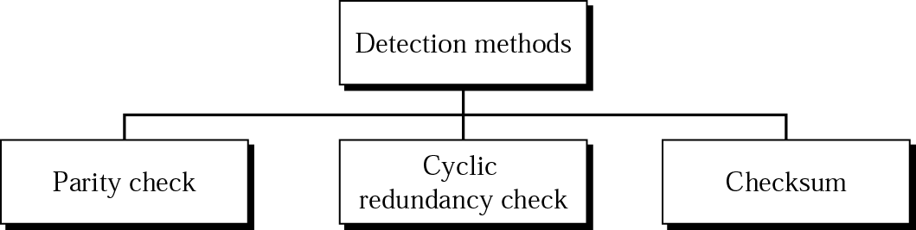
Error Detection Methods

Slide 10
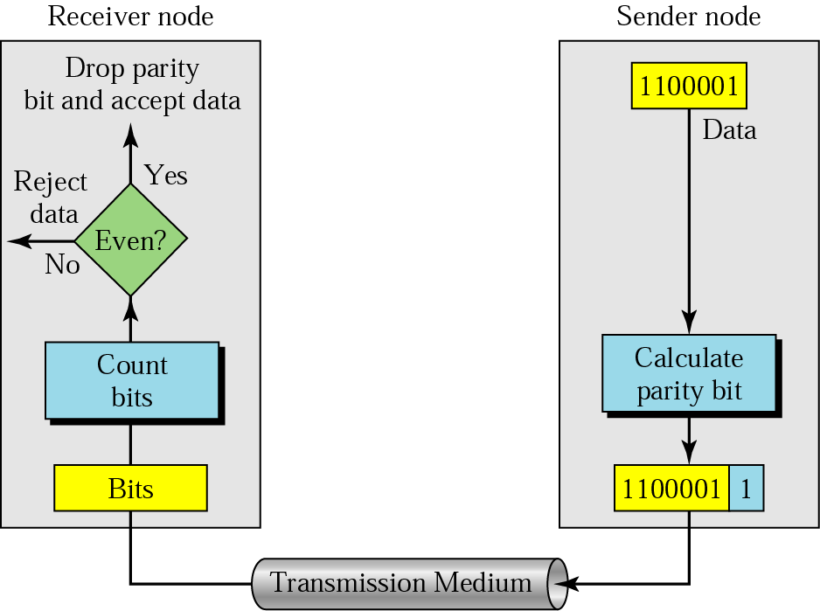
Parity Check(Vertical Redundancy Check)
A parity bit is added to every data unit so that the total number of 1s(including the parity bit) becomes even for even-parity check or odd for odd-parity check
Simple parity check

Slide 11
Detection- Example-1
Suppose the sender wants to send the word world. In ASCII the five characters are coded as
1110111 1101111 1110010 1101100 1100100
The following shows the actual bits sent
11101110 11011110 11100100 11011000 11001001

Slide 12
Detection – Example-2
Now suppose the word world in Example-1 is received by the receiver without being corrupted in transmission.
11101110 11011110 11100100 11011000 11001001
The receiver counts the 1s in each character and comes up with even numbers (6, 6, 4, 4, 4). The data are accepted.

Slide 13
Detection – Example-3
Now suppose the word world in Example-1 is corrupted during transmission.
11111110 11011110 11101100 11011000 11001001
The receiver counts the 1s in each character and comes up with even and odd numbers (7, 6, 5, 4, 4). The receiver knows that the data are corrupted, discards them, and asks for retransmission.

Slide 14
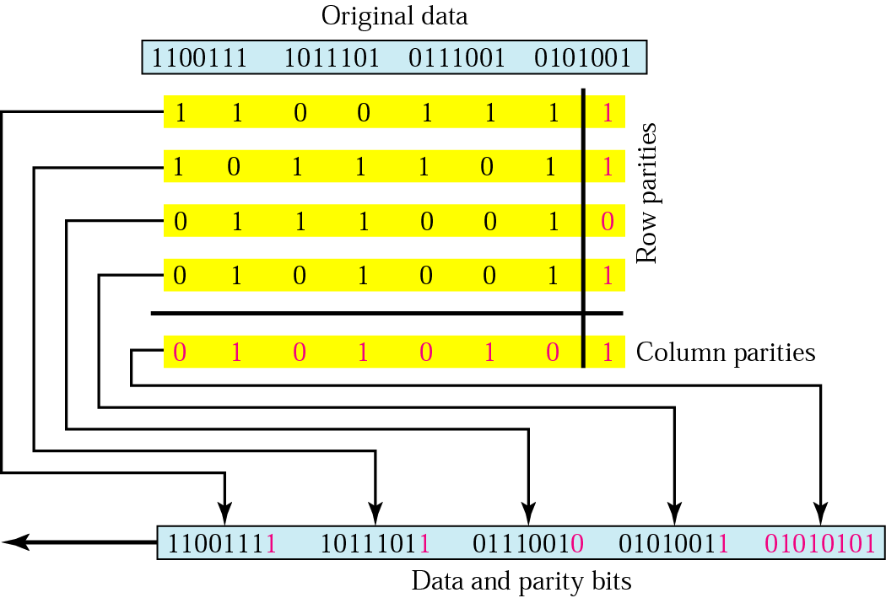
Two –Dimensional Parity Check (LRC) Longitudinal Redundancy Check

Slide 15
Detection – Example-4
Suppose the following block is sent:
10101001 00111001 11011101 11100111 10101010
However, it is hit by a burst noise of length 8, and some bits are corrupted.
10100011 10001001 11011101 11100111 10101010
When the receiver checks the parity bits, some of the bits do not follow the even-parity rule and the whole block is discarded.
10100011 10001001 11011101 11100111 10101010

Slide 16
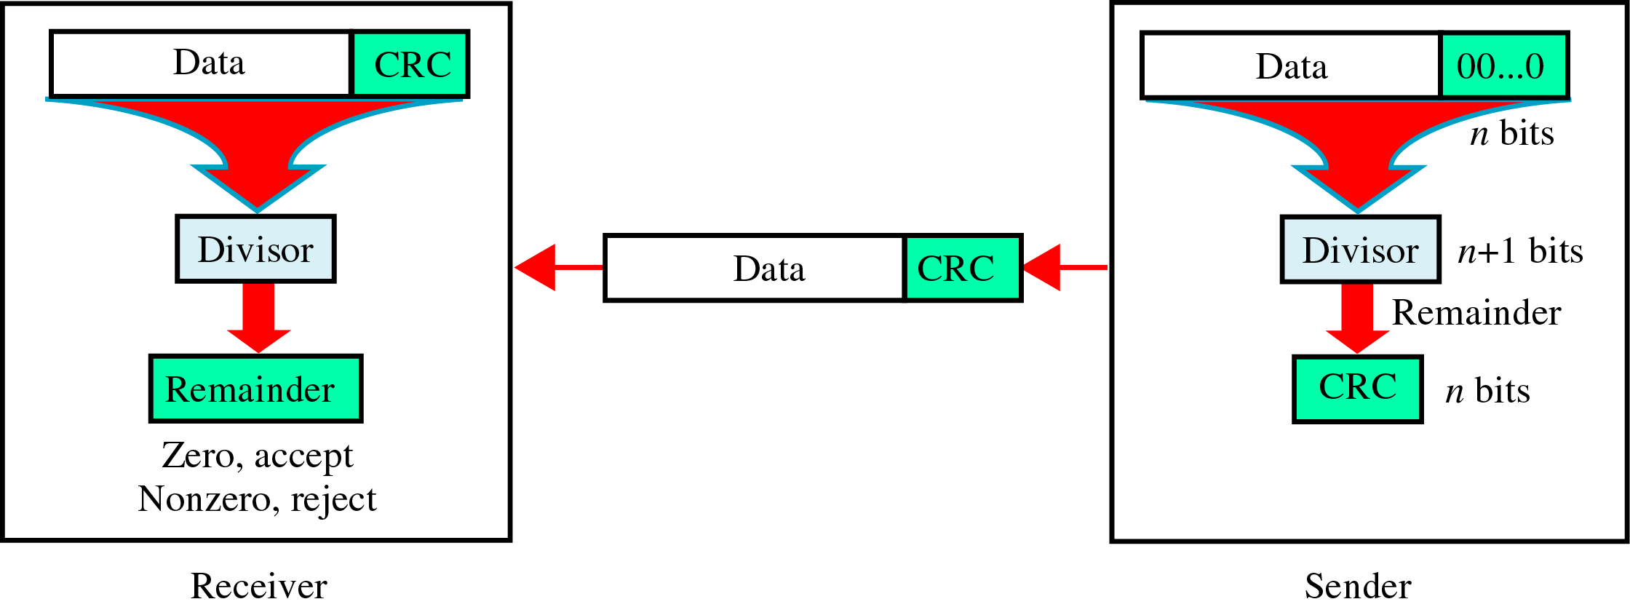
CRC(Cyclic Redundancy Check)
~ is based on binary division.

Slide 17
CRC generation at the sender
Length of divisor ‘L’
Append L-1 to original message
Binary division operation
Remainder is CRC, append to the data for transmission.
CRC= L-1 bits.

Slide 18
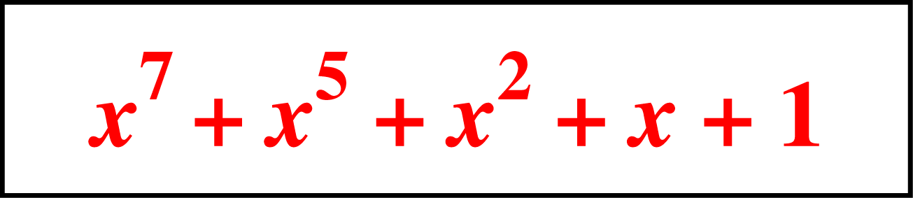
Detection(cont’d)
Polynomials
CRC generator(divisor) is most often represented not as a string of 1s and 0s, but as an algebraic polynomial.

Slide 19
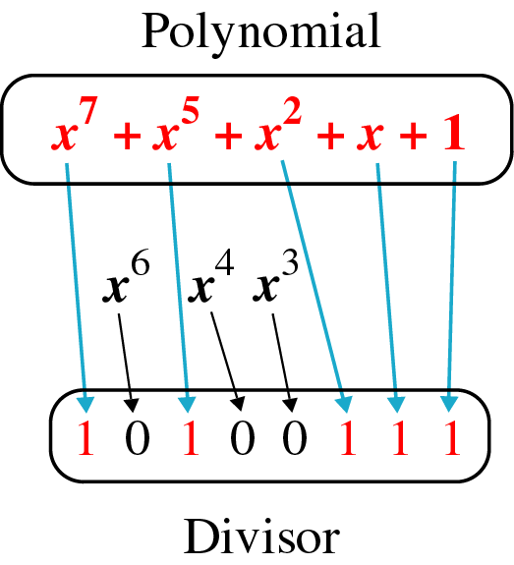
Detection(cont’d)
A polynomial representing a divisor

Slide 20
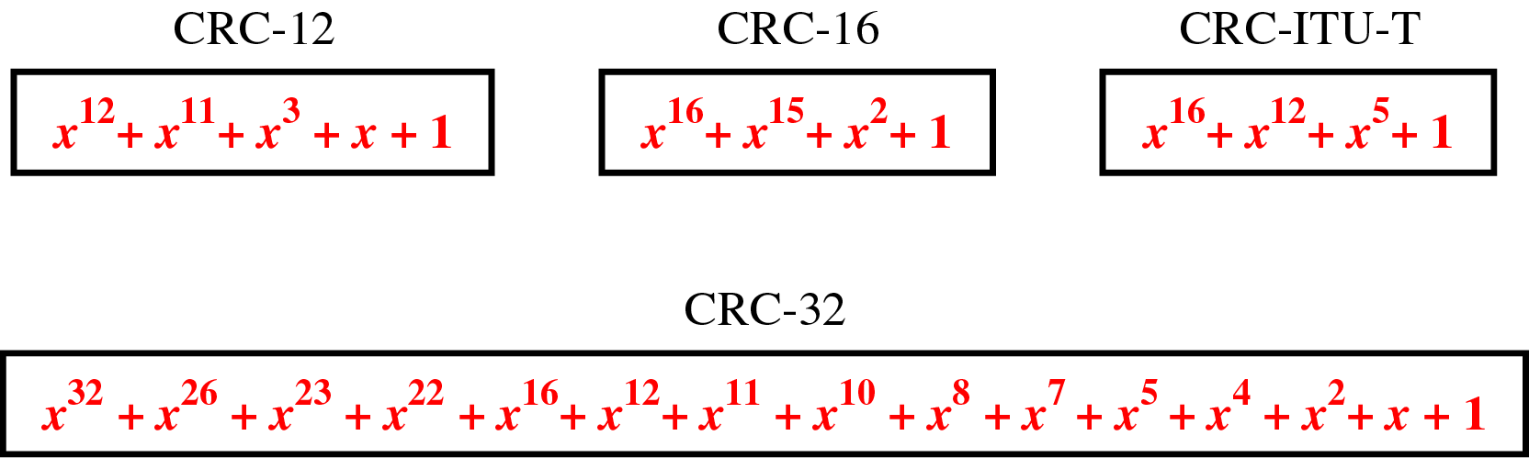
Detection(cont’d)
Standard polynomials

Slide 21
Eg
Polynomial : 100100
Divisor : 1101

Slide 22
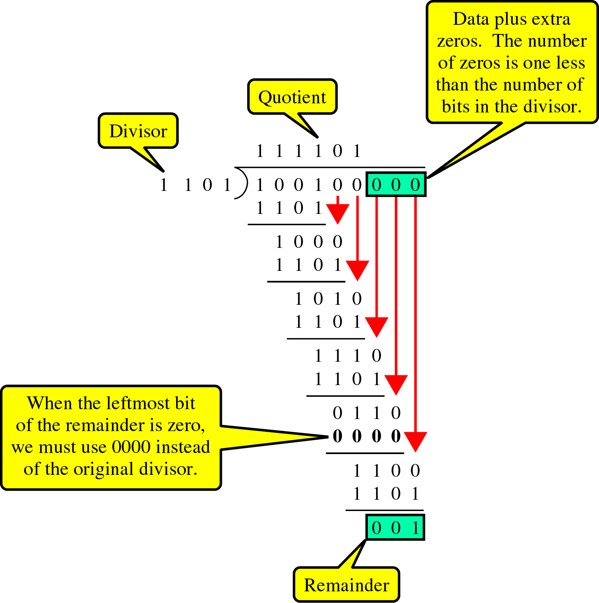
Sender
~ uses modular-2 division.
Binary Division
in a
CRC Generator

Slide 23
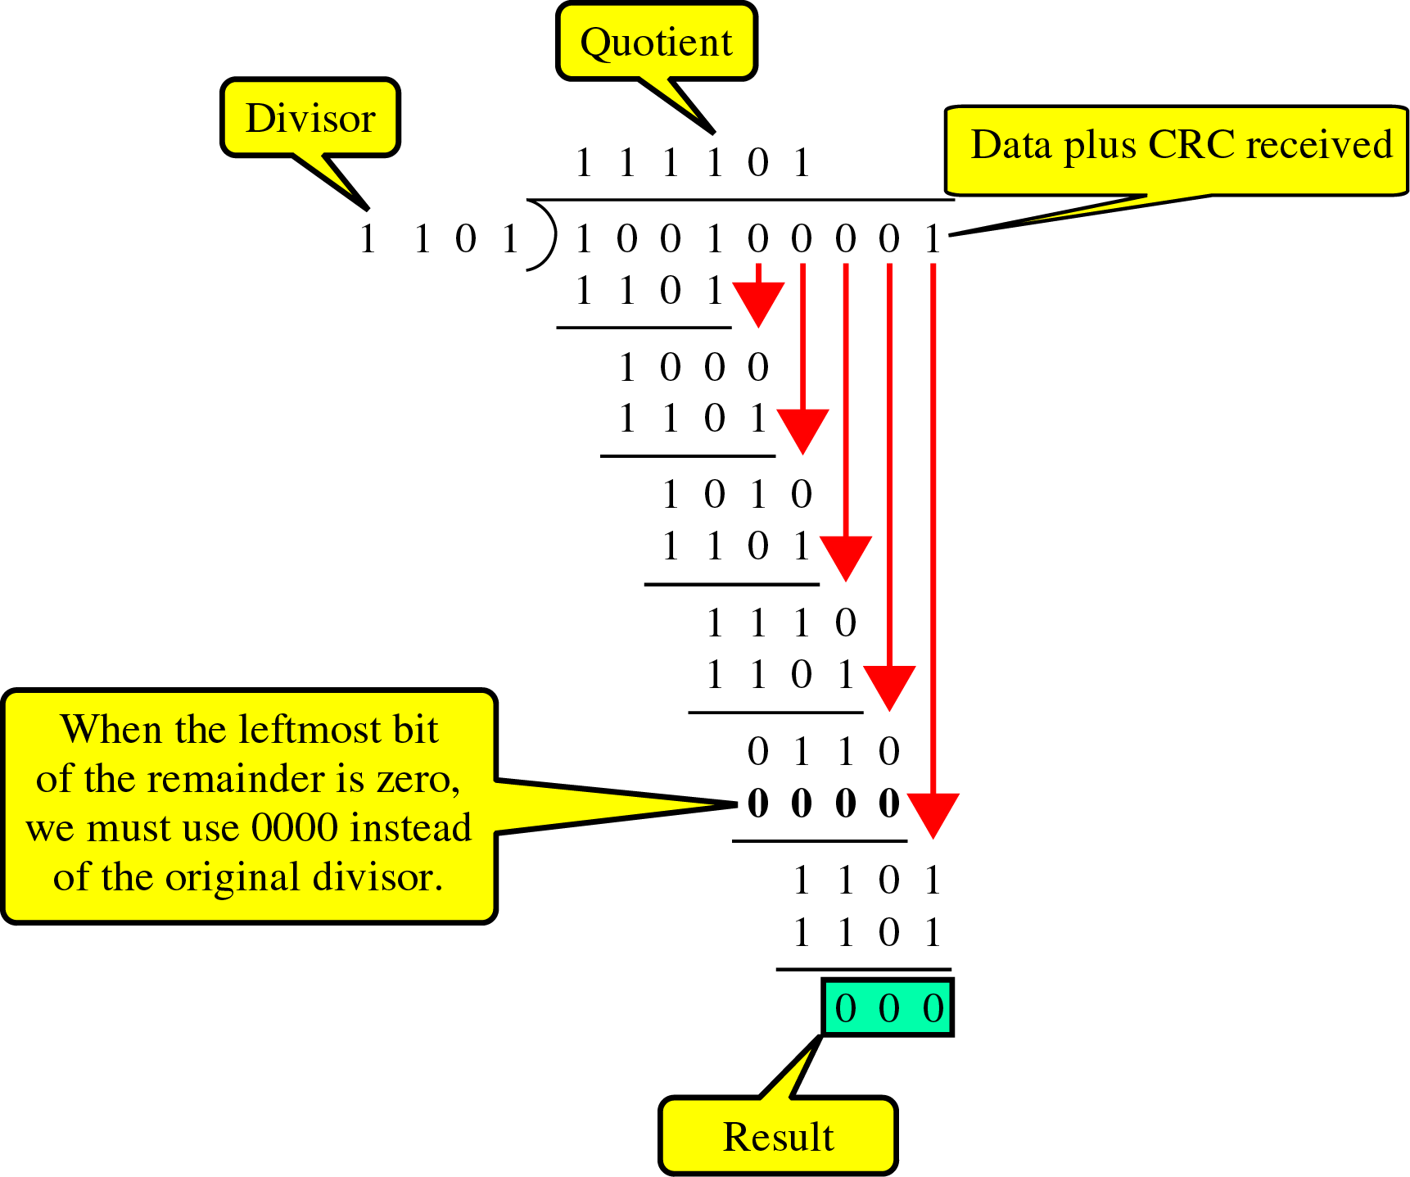
Receiver
Binary Division
in a
CRC Checker

Slide 24
Checksum
~ used by the higher layer protocols
~ is based on the concept of redundancy(VRC, LRC, CRC ….)

Slide 25
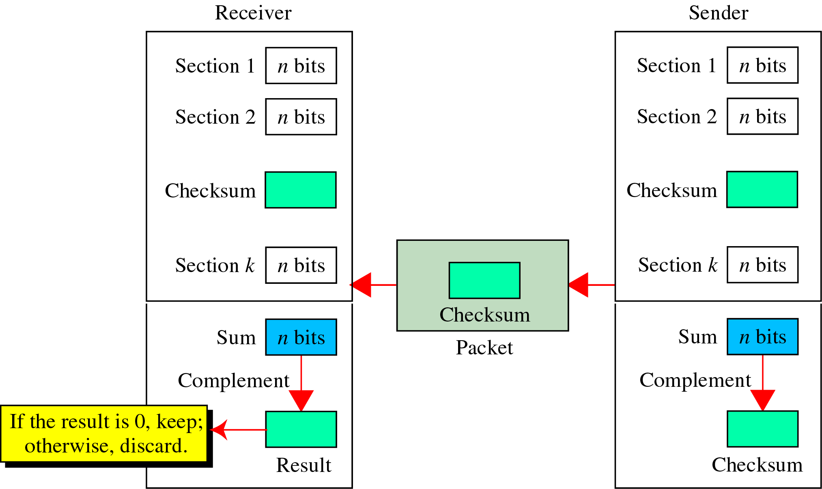
Checksum Generator

Slide 26
Detection(cont’d)
To create the checksum the sender does the following:
The unit is divided into K sections, each of n bits.
Sum all the bits in k blocks.
If carry exists add it to the sum.
The final result is complemented to make the checksum.

Slide 27
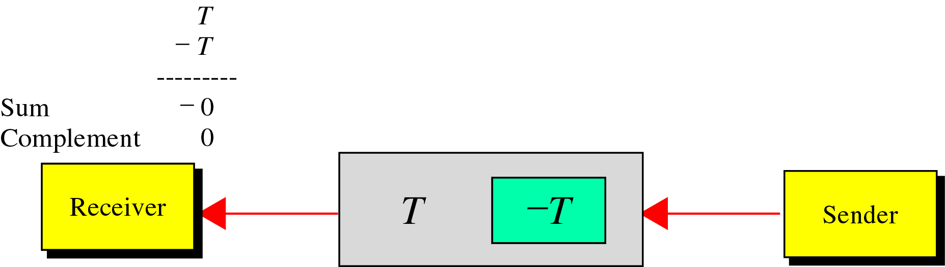
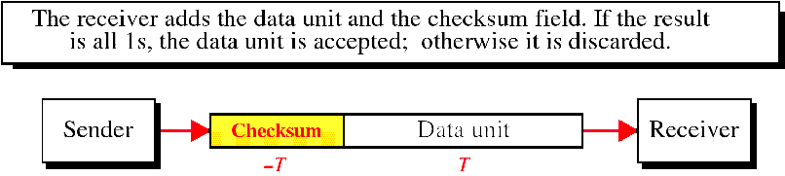
Detection(cont’d)
data unit and checksum

Slide 28
Detection(cont’d)
Sender
Original data : 10101001 00111001
10101001
00111001
--------------
11100010 Sum
00011101 Checksum
10101001 00111001 00011101 ← Checksum

Slide 29
Detection(cont’d)
Receiver
Received data : 10101001 00111001 00011101
10101001
00111001
00011101
---------------
11111111 ← Sum
00000000 ← Complement

